Slide 1
Lesson 16 – Homework review

Slide 2
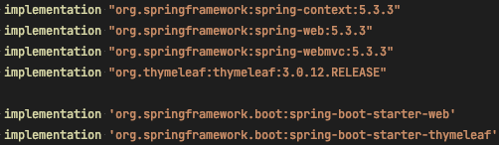
Redundant dependencies

Slide 3
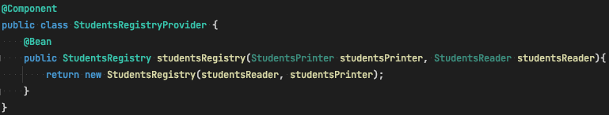
Class for usage of @Bean

Slide 4
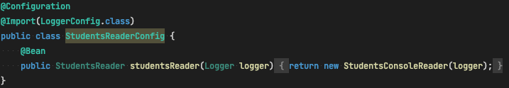
Avoid usage of @Import (most possible)

Slide 5
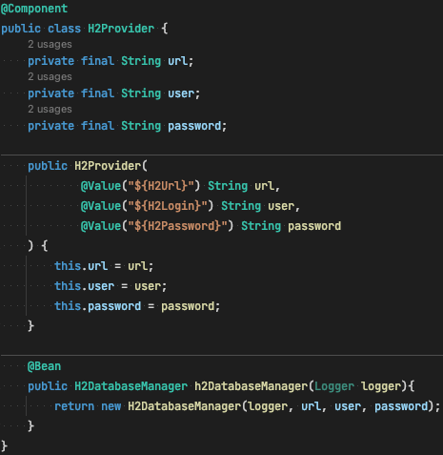
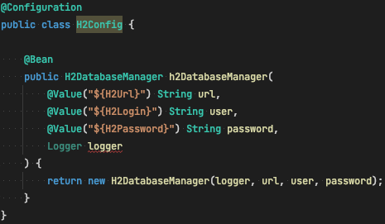
Injection of properties

Slide 6
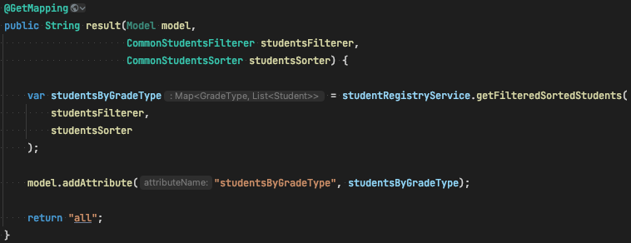
Inject carefully

Slide 7
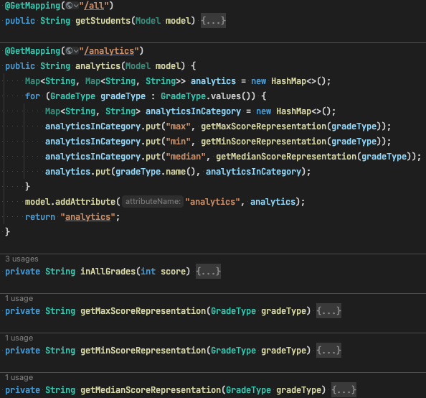
Small Controllers

Slide 8
Thanks!
Any Questions?
Or find us in Slack:
@Yaroslav Brahinets
@Vasya Rudas

